Slide 1



FINAL PROJECT PRESENTATİON
Selin UZUNOĞLU 202011041
Serhat YILDIZ 202211404
Kübra Begüm ÜLEŞ 201611059
Hamza Basil WAHEED 201911500
Samed Tuğkan ÇİNKO 201811020
Taha Emre KARATAŞ 202011025
ADVISOR OF THE PROJECT:
Abdül Kadir Görür

Slide 2
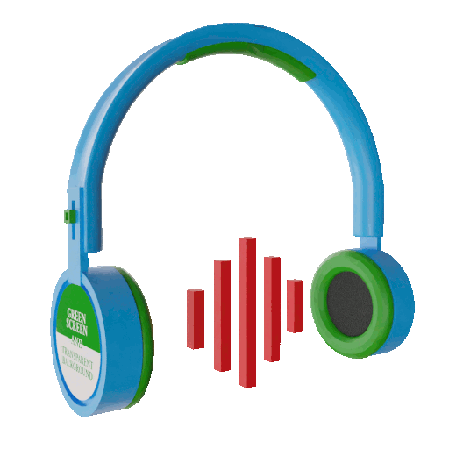
WHAT IS EMOTAGGER?
Music and Emotion Survey Application This project aims to explore the emotional impact of music through a user-friendly web-based survey application. Users listen to music tracks and select the emotion they feel among six predefined categories: Joyful, Melancholic, Energetic, Calm, Angry, and Nostalgic. The selected emotion, along with relevant metadata, is stored in a structured database for further analysis. The application provides an intuitive interface supported by custom emotion icons to enhance user experience. It is developed using modern technologies with a focus on clean data collection, scalability, and user privacy. The gathered data can support psychological research, personalized music recommendations, and emotion-based content analysis. The project is collaboratively managed using GitHub, with continuous updates to documentation (SRS & SDD), test plans, and development progress. Future improvements include AI-based emotion prediction and mobile app integration.

Slide 3
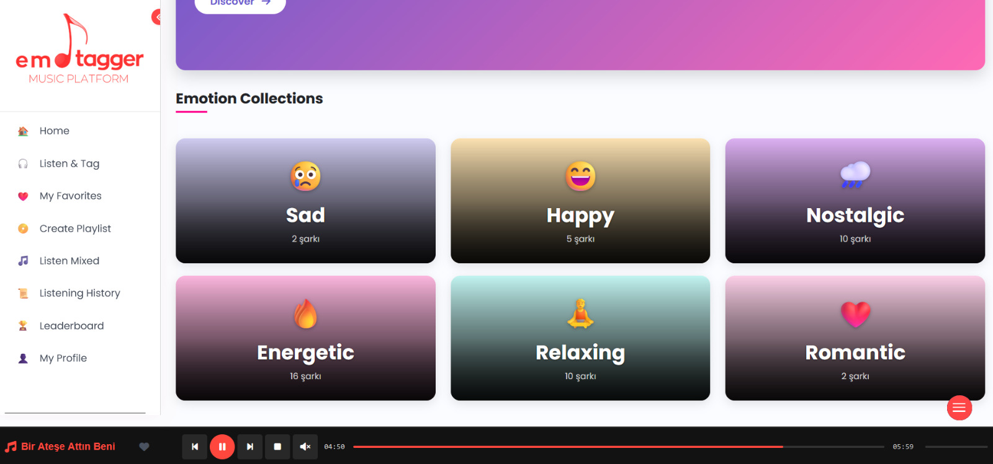

HOME PAGE
Discover how music makes you feel. In this platform, you can listen to a variety of music tracks and simply select the emotion you experience while listening. Whether it's Joyful, Melancholic, Energetic, Calm, Angry, or Nostalgic, your feedback helps us understand the emotional impact of music.
Your responses are recorded anonymously and used for research and improvement of emotion-based music experiences.
Start listening, feel the rhythm, and share your emotion!

Slide 4
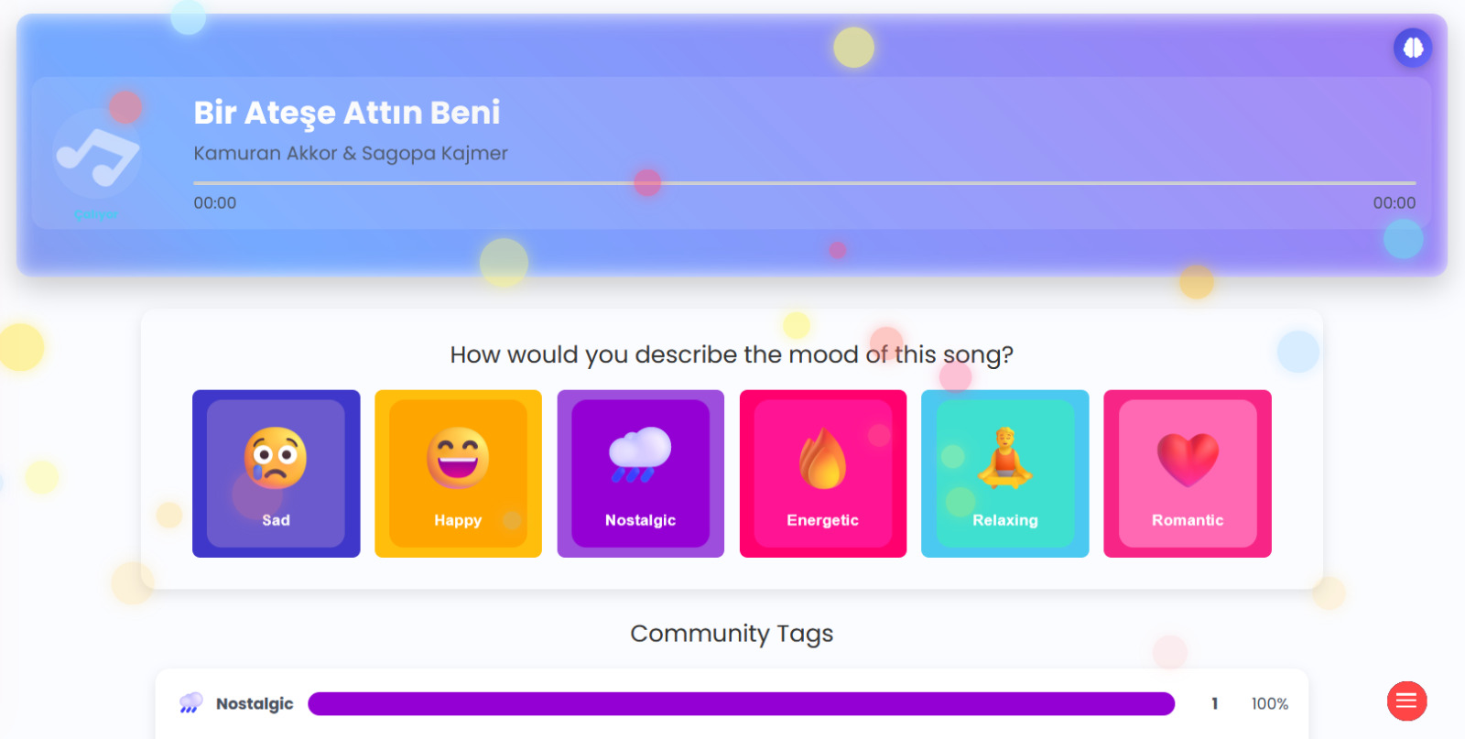

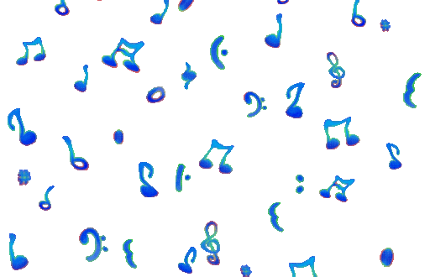

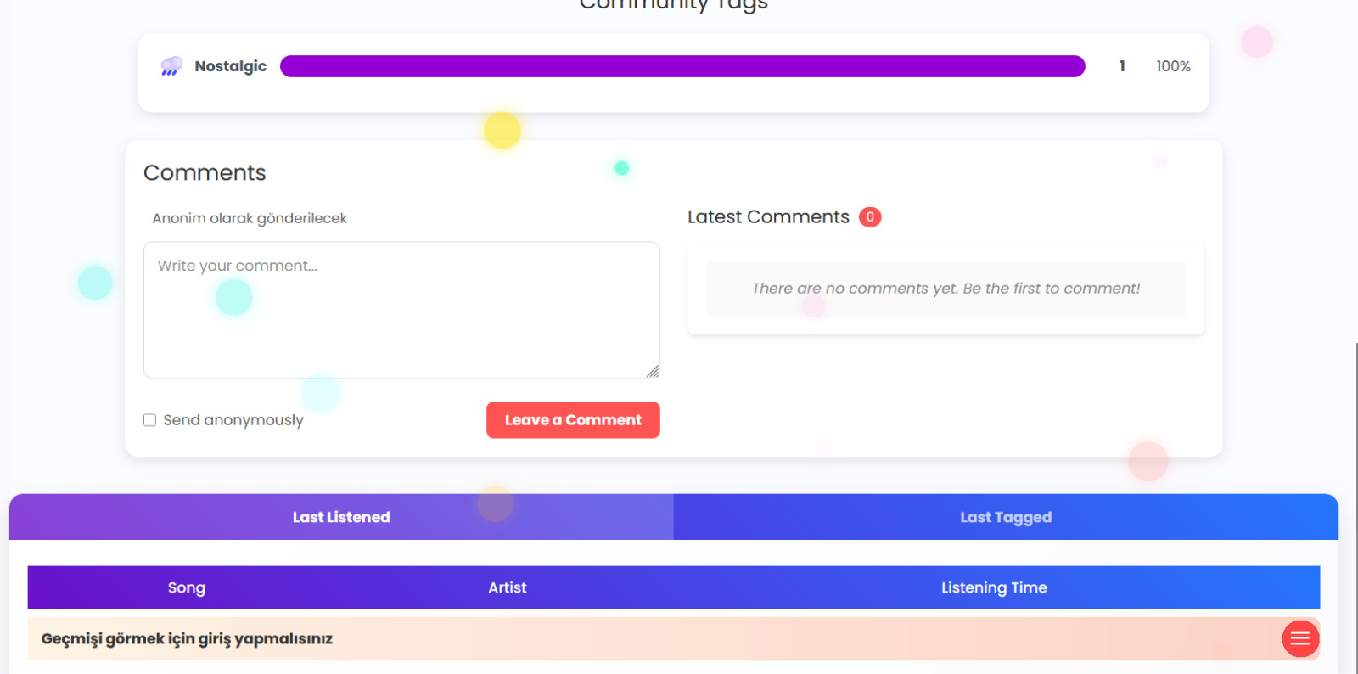
LISTEN TAG
Listen to a track and choose the emotion it makes you feel. Your response helps us understand music’s emotional impact.

Slide 5
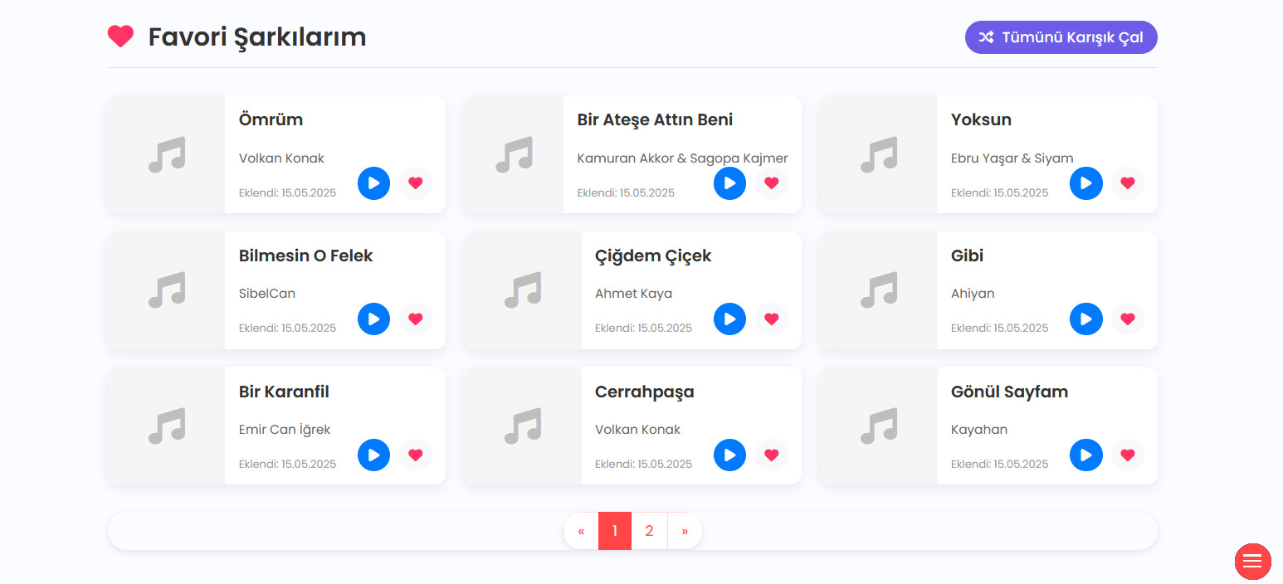
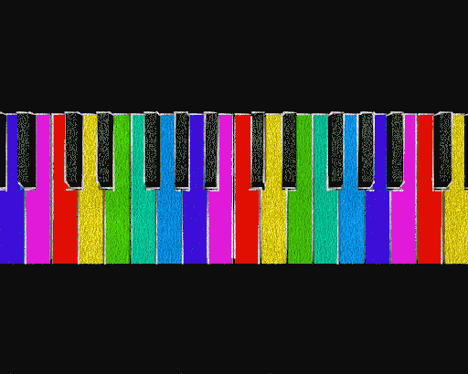
FAVORITE LIST
View and manage the tracks you've marked as favorites for easy access later.

Slide 6
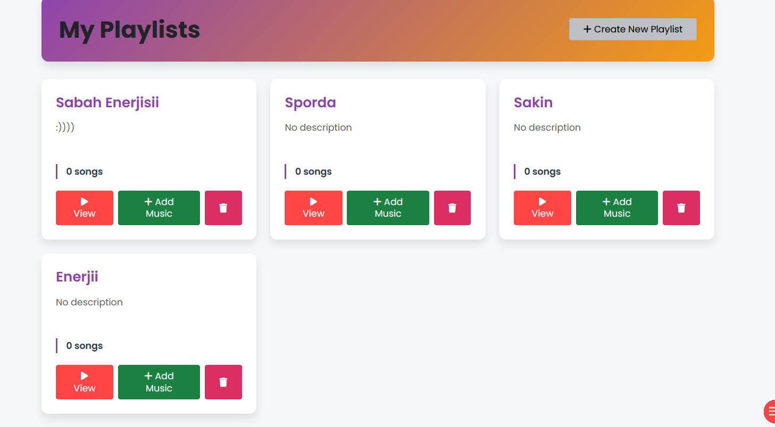

PLAYLIST
Explore curated music collections based on mood and theme.

Slide 7
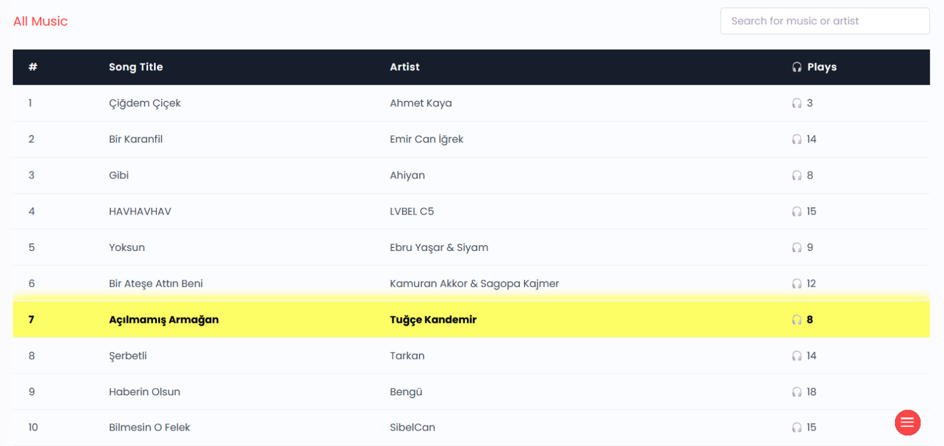
LISTEN MIXED
Listen to a random mix of tracks from all moods and tag how they make you feel.

Slide 8
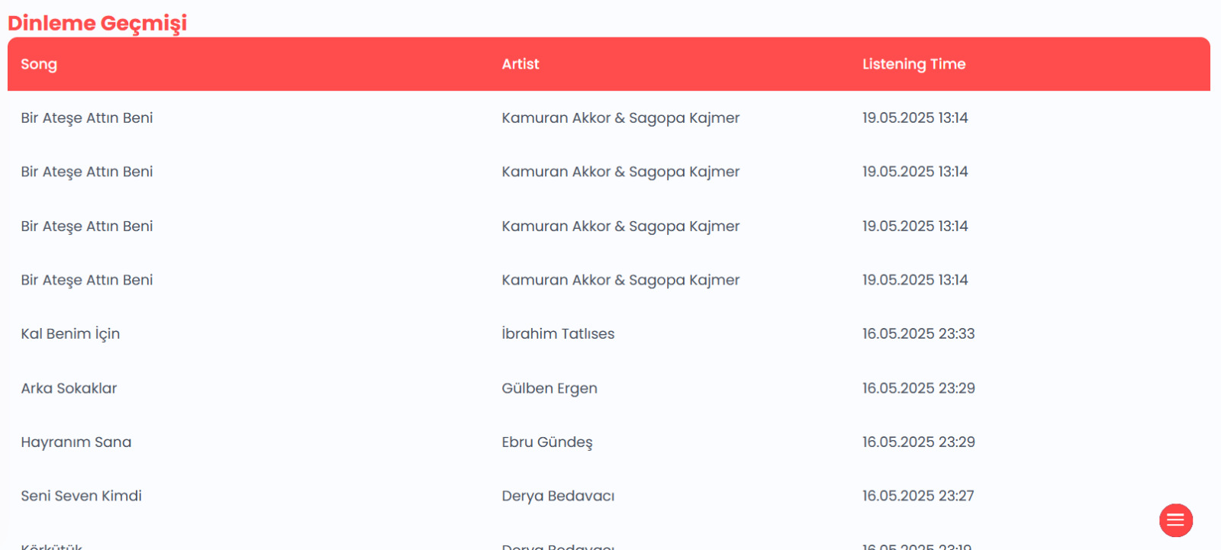
HISTORY
View the tracks you've listened to and the emotions you tagged.

Slide 9
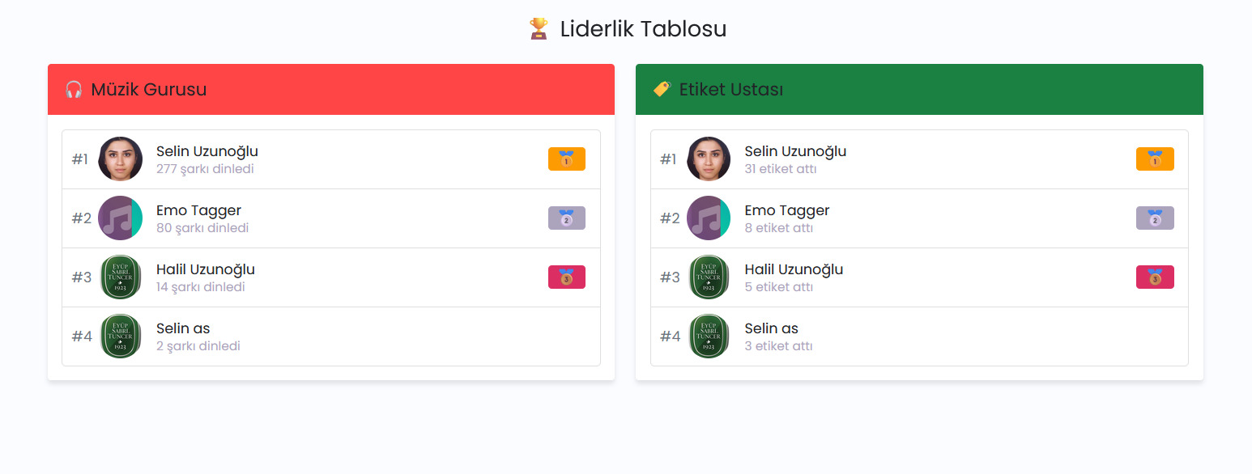
LEADERBOARD
See top contributors based on tagging activity and engagement.

Slide 10
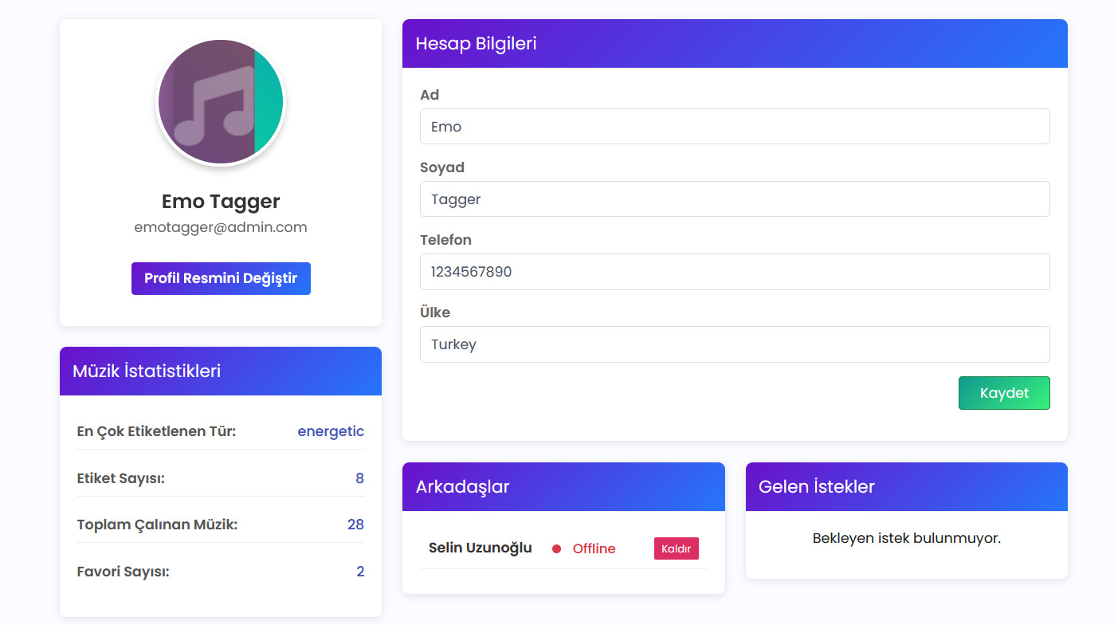
PROFILE
View and manage your personal info, favorites, and activity stats.

Slide 11
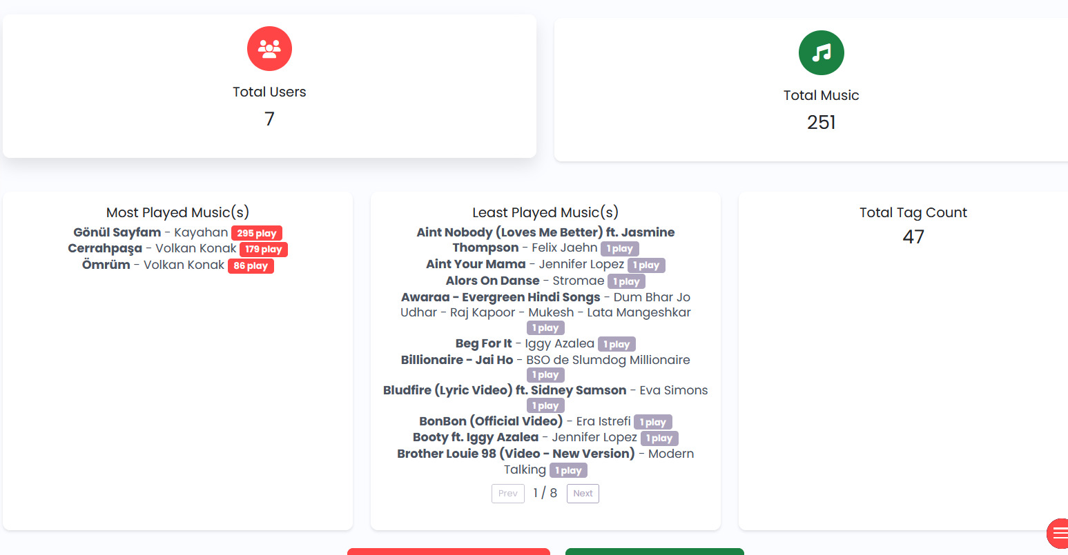
ADMIN CONTROL PANEL
Manage users, tracks, and system data with full administrative control.

Slide 12
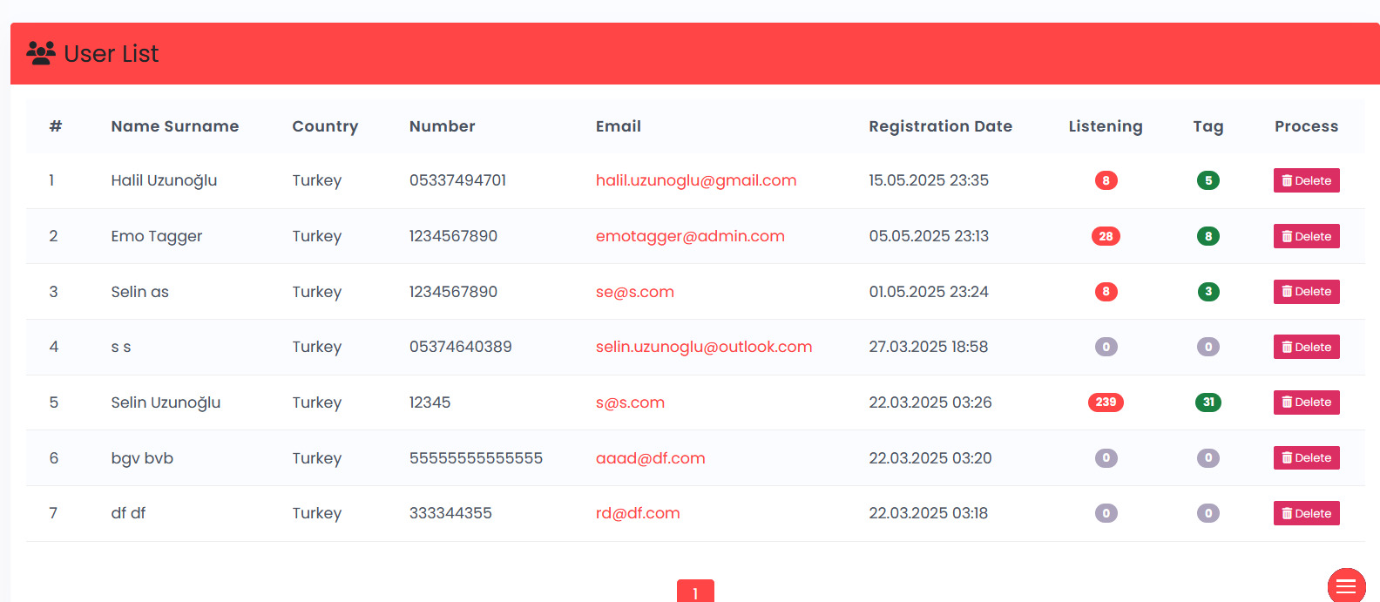
ADMIN USERS
View, edit, or remove user accounts and monitor activity.

Slide 13
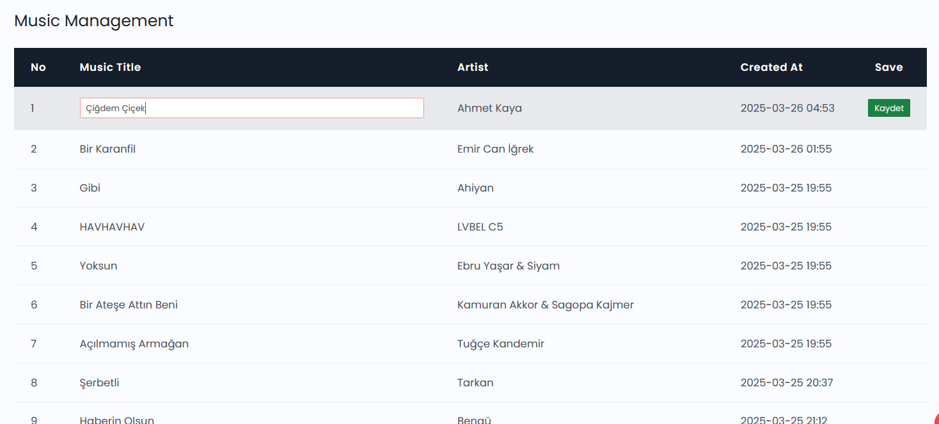
MUSIC MANAGEMENT
Add, edit, or delete music tracks and organize them by category or mood.

Slide 14
AI
The AI component of the EmoTagger project is built upon a robust, multi-model architecture that integrates user behavior, audio signal processing, and natural language understanding to classify the emotional tone of music from diverse perspectives. Model 1 serves as the foundation, utilizing a rule-based approach that analyzes user-submitted emotion tags stored in a PostgreSQL database. For each song, it aggregates all associated tags and determines the most frequently selected emotion, designating it as the song’s "Predicted Emotion." This model reflects collective listener sentiment, offering a reliable label derived from actual user interaction. Model 2 introduces a deep learning-based strategy that focuses on the audio characteristics of the song. It first extracts acoustic features using a custom extract_features function—typically capturing temporal and spectral data such as MFCCs—and then trains a feedforward neural network to classify songs into predefined emotion categories. This model is trained using the outputs of Model 1 to maintain consistency and is capable of independently predicting emotions even without user tags. The final model, Model 3, leverages natural language processing (NLP) to analyze lyrical content. Using the Whisper model, it transcribes spoken or sung lyrics from audio files and classifies the resulting text using pre-trained emotion classifiers such as distilroberta-base for English and facebook/bart-large-mnli with translation support for Turkish. This enables accurate emotion prediction based on lyrical expression and sentiment. Combined, these three models provide a comprehensive, AI-driven framework for understanding musical emotions: Model 1 captures user perception, Model 2 analyzes audio emotion, and Model 3 interprets lyrical emotion, creating a powerful system for emotion-aware music analysis and recommendation.

Slide 15
FINAL
Thank you for listening to our presentation.
With this project, we aimed to explore how music affects emotions and to create an intuitive platform where users can express what they feel through sound. Throughout the development process, we focused on simplicity, user experience, and meaningful data collection.
We believe this application can contribute to both academic research and music-related technologies in the future.
We would like to thank our advisor and instructors for their guidance, and we look forward to improving and expanding this project beyond the course.
Thank you again!

